Slide 1
Capstone Project – 1
Predi ct ing Prop erty Pric es in a Speci fi c Lo catio n Using Mach in e Lear ning
Submitted By
Khushnaz
Batch: - Data Science & AI (P-150924-E8-SS-30)
Date of Submission: - 01/04/2025
Institution: - Digicrome Academy
INTRODUCTION TO THE PROJECT :-
Our project aims to develop a machine learning model for accurately predicting property prices in a specific location. The accurate prediction of property prices is crucial for various stakeholders, including real estate investors, property developers, and homebuyers, as it facilitates informed decision-making in the real estate market.
PROBLEM STATEMENT: -
The real estate market is a complex and dynamic field influenced by numerous factors such as location, property size, neighbourhood features, and amenities. For buyers, sellers, and agents, accurately predicting property prices poses a significant challenge. Traditional methods may struggle to process large datasets and identify intricate patterns. This project aims to address this challenge by leveraging machine learning to predict property prices in a specific location with precision. The goal is to create a reliable, data-driven model that analyses key variables, handles missing data effectively, and produces accurate predictions to assist real estate stakeholders in making informed decisions.

Slide 2
OBJECTIVE OF THE PROJECT: -
The primary objective of this project is to leverage machine learning techniques to accurately predict property prices in a specific location. This involves the following:
  Collecting and cleaning real estate data, handling missing data effectively.
  Conducting exploratory data analysis (EDA) to identify key factors that influence property prices.
  Implementing techniques like scaling, PCA, and encoding to preprocess data effectively.
  Developing, training, and testing a machine learning model that uses selected variables for prediction.
  Evaluating and comparing model performance using metrics like R², MAE, and RMSE.
  Presenting insights into significant factors affecting property prices and delivering a comprehensive report with findings.
The overarching goal is to create a reliable machine learning model that supports real estate stakeholders by providing accurate property price predictions.
FLOWCHART OF THE OPERATION:-
  Data Collection: Gathering real estate data.
  Data Cleaning: Handling missing values and outliers.
  Exploratory Data Analysis (EDA): Identifying influential features.
  Feature Engineering: Creating new variables for improved model accuracy.

Slide 3
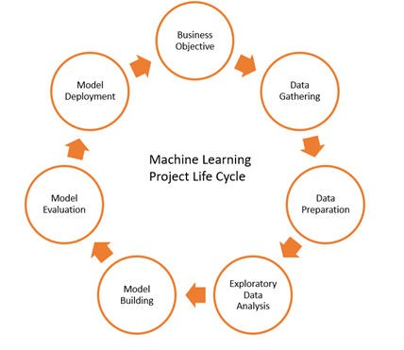
Model Selection: Evaluating machine learning algorithms.
Model Training and Testing: Training the model and assessing performance.
Model Evaluation: Comparing metrics like MAE and RMSE.
Model Deployment: Using the model for property price prediction.

Slide 4
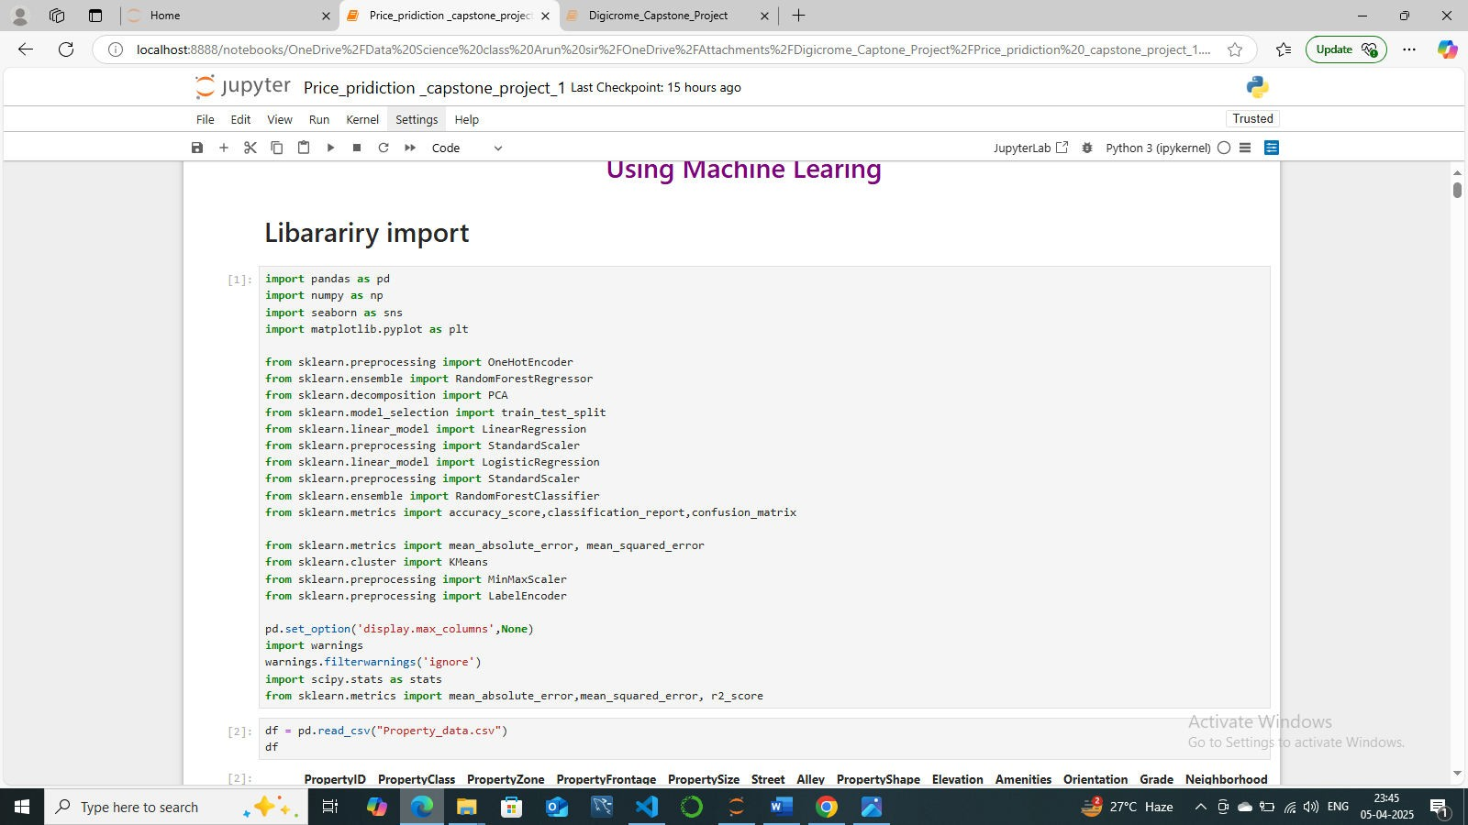
5. IMPORTANT LIBRARIES:-
ALL THE CODE WHICH IS USING TO MAKE THIS PROJECT(MACHINE LEARNING:-
df=pd.read_csv("Property_data.csv")
print(shape)# print the shape of data
check all the columns in the dataframe
df.columns
# Getting the informaatin of the data df.info()
Summary Statistics

Slide 5
df.describe(include='all')
#calculate no percentiles for each numeric variable df.describe(percentiles=[])
Histrogram
# Assuming df is your DataFrame
numerical_cols = df.select_dtypes(include=['int', 'float']).columns
# Set up the matplotlib figure plt.figure(figsize=(20, 20))
# Iterate over each numerical column and create a subplot for each for i, col in enumerate(numerical_cols, 1):
plt.subplot(len(numerical_cols) // 3 + 1, 3, i) sns.histplot(df[col], bins=50, kde=True) plt.title(f'Distribution of {col}') plt.xlabel(col)
plt.ylabel('Frequency')
plt.tight_layout() plt.show()
Boxplot
# Set up the figure with subplots
num_cols = len(df.select_dtypes(include=['int', 'float']).columns) fig, axes = plt.subplots(num_cols, 1, figsize=(12, 5*num_cols))
# Plot boxplot for each numerical column
for i, col in enumerate(df.select_dtypes(include=['int', 'float']).columns): sns.boxplot(x=df[col], ax=axes[i], palette='Set2') axes[i].set_title(f'Boxplot of {col}')
axes[i].set_xlabel(col)

Slide 6
plt.tight_layout() plt.show()
Model selection
import pandas as pd
from sklearn.model_selection import train_test_split from sklearn.preprocessing import StandardScaler from sklearn.linear_model import LinearRegression
from sklearn.neighbors import KNeighborsRegressor from sklearn.svm import SVR
from sklearn.ensemble import RandomForestRegressor from sklearn.impute import SimpleImputer
from sklearn.metrics import mean_squared_error, r2_score
#Identify and separate numerical and categorical columns numerical_data = df.select_dtypes(include=['int64', 'float64']) categorical_data = df.select_dtypes(include=['object'])
# Encode the categorical columns using one-hot encoding
encoded_categorical_data = pd.get_dummies(categorical_data, drop_first=True)
# Combine the numerical and encoded categorical columns into a single DataFrame encoded_data = pd.concat([numerical_data, encoded_categorical_data], axis=1)
#Handle missing values
imputer = SimpleImputer(strategy='mean')
encoded_data_imputed =
pd.DataFrame(imputer.fit_transform(encoded_data),
columns=encoded_data.columns)
#Separate features and target variable
X = encoded_data_imputed.drop('SalePrice', axis=1) y = encoded_data_imputed['SalePrice']
#Split the data into training and testing sets
X_train, X_test, y_train, y_test = train_test_split(X, random_state=42)
y, test_size=0.2,
#Standardize the features

Slide 7
scaler = StandardScaler()
X_train_scaled = scaler.fit_transform(X_train) X_test_scaled = scaler.transform(X_test)
Train and evaluate multiple regression models
# Linear Regression
model_linear = LinearRegression() model_linear.fit(X_train_scaled, y_train) linear_predictions = model_linear.predict(X_test_scaled)
print("Linear Regression")
print(f"Mean Squared Error: {mean_squared_error(y_test, linear_predictions)}") print(f"R^2 Score: {r2_score(y_test, linear_predictions)}")
# KNN Regressor
model_knn = KNeighborsRegressor() model_knn.fit(X_train_scaled, y_train) knn_predictions = model_knn.predict(X_test_scaled) print("\nKNN Regressor")
print(f"Mean Squared Error: {mean_squared_error(y_test, knn_predictions)}") print(f"R^2 Score: {r2_score(y_test, knn_predictions)}")
# Support Vector Regressor model_svr = SVR()
model_svr.fit(X_train_scaled, y_train) svr_predictions = model_svr.predict(X_test_scaled) print("\nSupport Vector Regressor")
print(f"Mean Squared Error: {mean_squared_error(y_test, svr_predictions)}") print(f"R^2 Score: {r2_score(y_test, svr_predictions)}")
# Random Forest Regressor
model_rf = RandomForestRegressor() model_rf.fit(X_train_scaled, y_train) rf_predictions = model_rf.predict(X_test_scaled) print("\nRandom Forest Regressor")
print(f"Mean Squared Error: {mean_squared_error(y_test, rf_predictions)}")

Slide 8
print(f"R^2 Score: {r2_score(y_test, rf_predictions)}")
#Initialize a dictionary to collect metrics metrics_dict = {}
# Linear Regression
model_linear = LinearRegression() model_linear.fit(X_train_scaled, y_train) linear_predictions = model_linear.predict(X_test_scaled) linear_metrics = {
'Mean Squared Error': mean_squared_error(y_test, linear_predictions), 'R^2 Score': r2_score(y_test, linear_predictions)
}
metrics_dict['Linear Regression'] = linear_metrics
# KNN Regressor
model_knn = KNeighborsRegressor() model_knn.fit(X_train_scaled, y_train) knn_predictions = model_knn.predict(X_test_scaled)
knn_metrics = {
'Mean Squared Error': mean_squared_error(y_test, knn_predictions), 'R^2 Score': r2_score(y_test, knn_predictions)
}
metrics_dict['KNN Regressor'] = knn_metrics
# Support Vector Regressor model_svr = SVR()
model_svr.fit(X_train_scaled, y_train)
svr_predictions = model_svr.predict(X_test_scaled) svr_metrics = {
'Mean Squared Error': mean_squared_error(y_test, svr_predictions), 'R^2 Score': r2_score(y_test, svr_predictions)
}
metrics_dict['Support Vector Regressor'] = svr_metrics
# Random Forest Regressor

Slide 9
model_rf = RandomForestRegressor() model_rf.fit(X_train_scaled, y_train) rf_predictions = model_rf.predict(X_test_scaled)
rf_metrics = {
'Mean Squared Error': mean_squared_error(y_test, rf_predictions), 'R^2 Score': r2_score(y_test, rf_predictions)
}
metrics_dict['Random Forest Regressor'] = rf_metrics
#Initialize the RandomForestRegressor
rf_model = RandomForestRegressor(n_estimators=100, random_state=42)
# Train the model rf_model.fit(X_train, y_train)
# Extract feature importance
feature_importance = rf_model.feature_importances_
# Create a DataFrame to store feature importance along with feature names
feature_importance_df = pd.DataFrame({'Feature': X.columns, 'Importance': feature_importance})
# Sort features by importance
feature_importance_df = ascending=False)
feature_importance_df.sort_values(by='Importance',
# Plot feature importance plt.figure(figsize=(10, 6))
plt.barh(feature_importance_df['Feature'], color='skyblue')
plt.xlabel('Importance') plt.title('Feature Importance')
feature_importance_df['Importance'],
plt.gca().invert_yaxis() the top
plt.show()
# Invert y-axis to have the most important features at

Slide 10
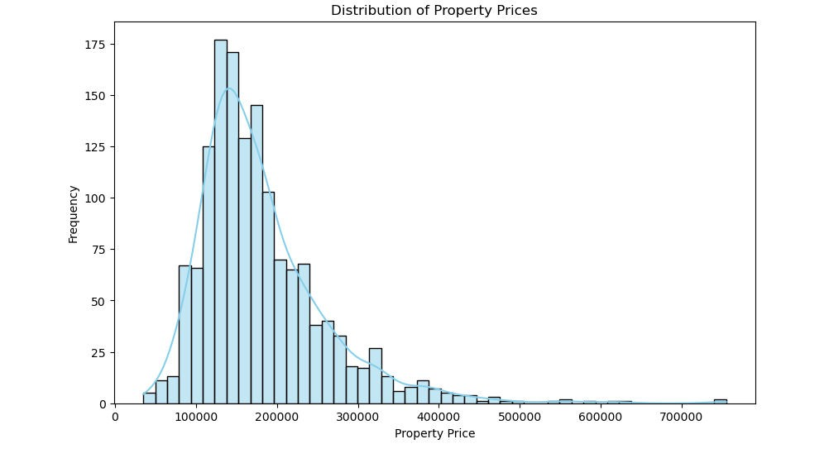
# Print top N significant features
top_n_features = 10 # Specify the number of top features to display
print(f'Top {top_n_features} significant features:') feature_importance_df.head(top_n_features)
Data Distribution

Slide 11
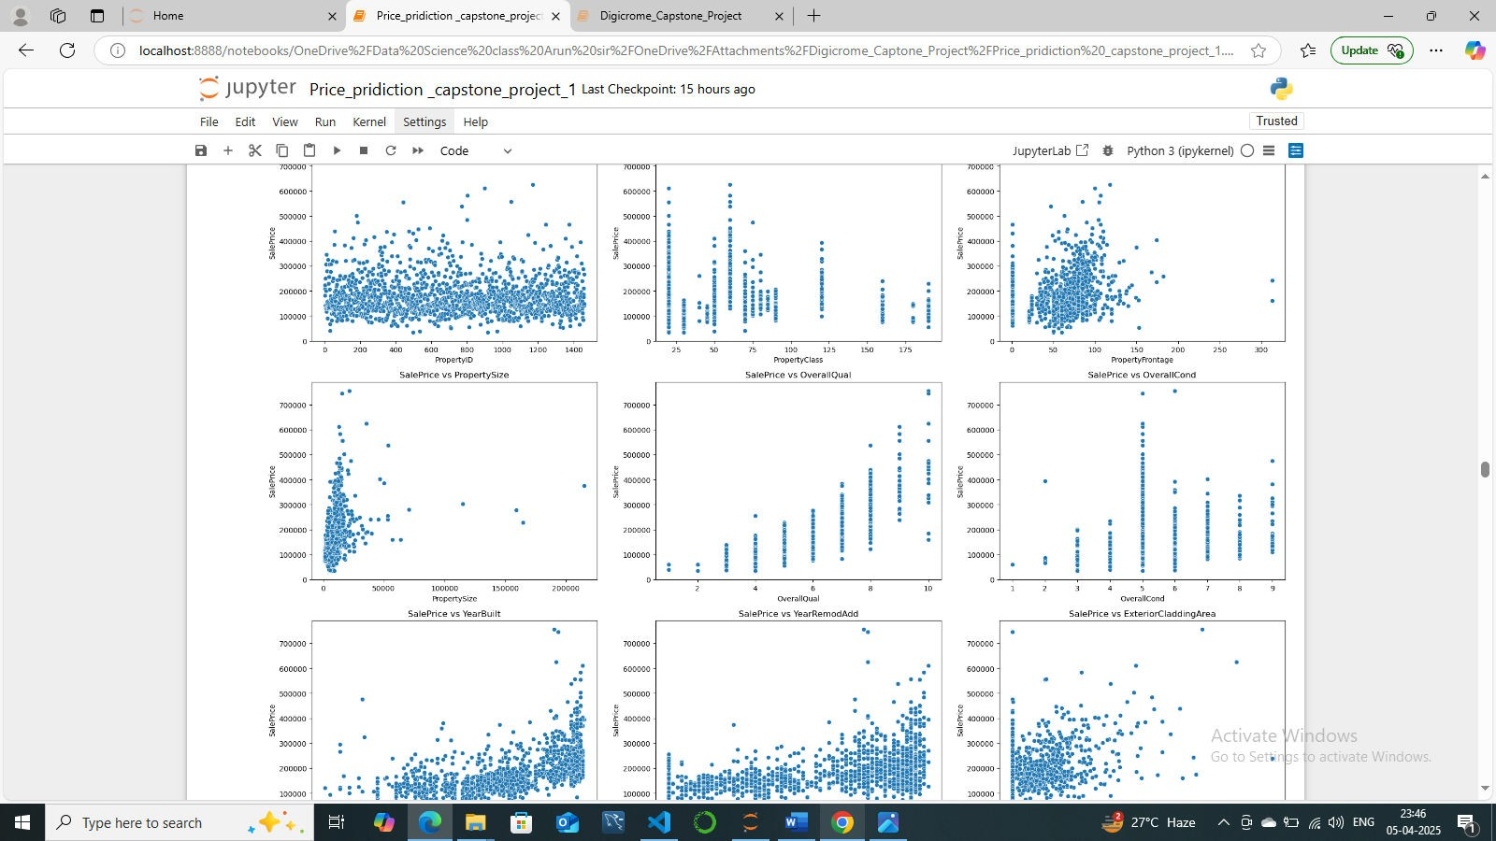
Data Visualization
Distribution of SalePrice

Slide 12
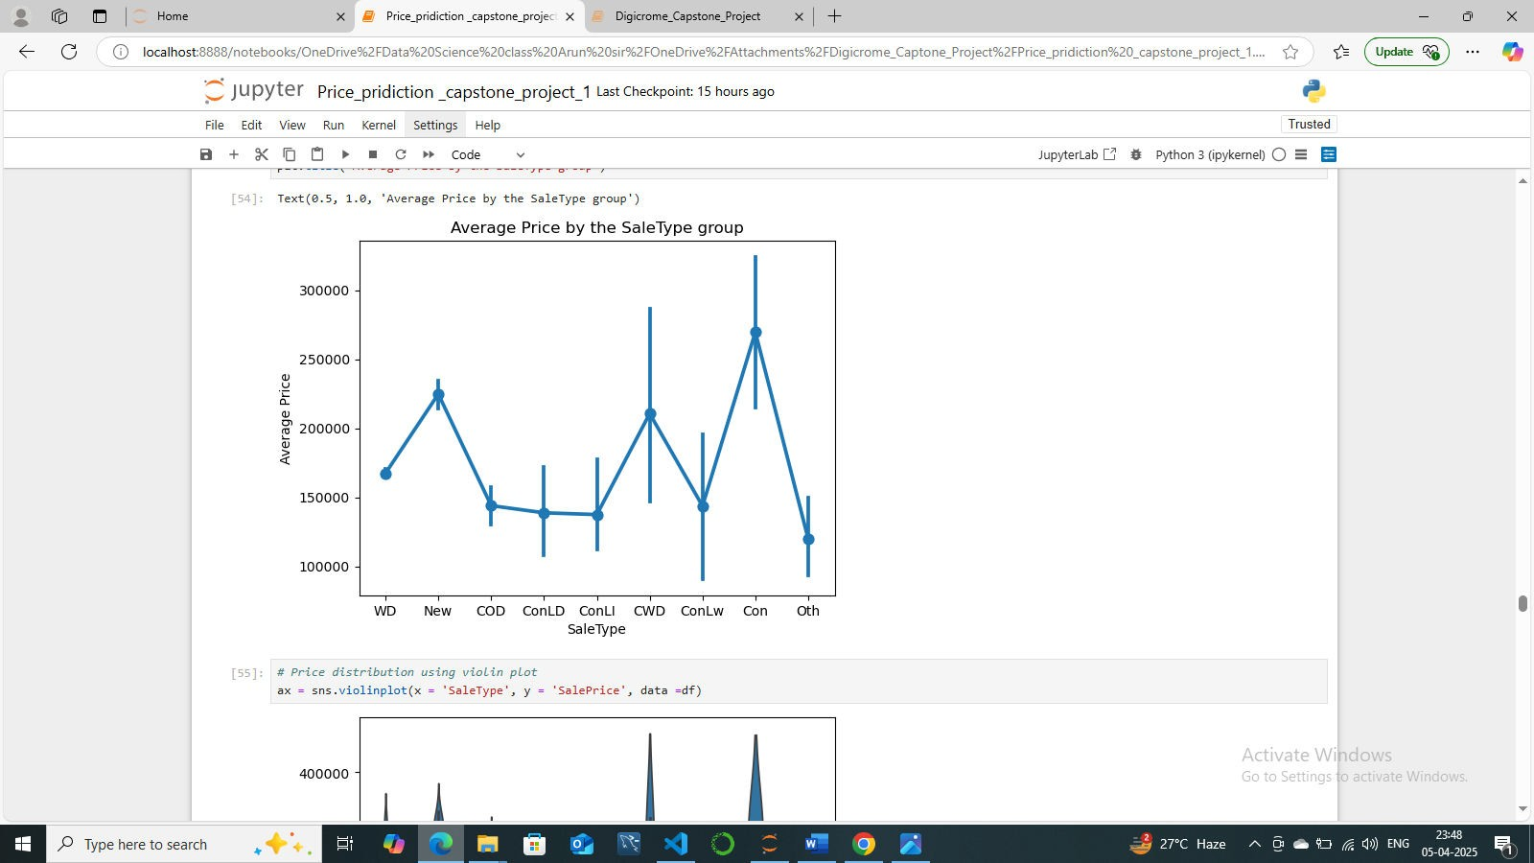
Distribution Shape:
The distribution of house prices is likely right-skewed, meaning there are more properties priced at the lower end with a tail extending towards higher prices. The presence of a peak indicates the most common price range for the properties.

Slide 13
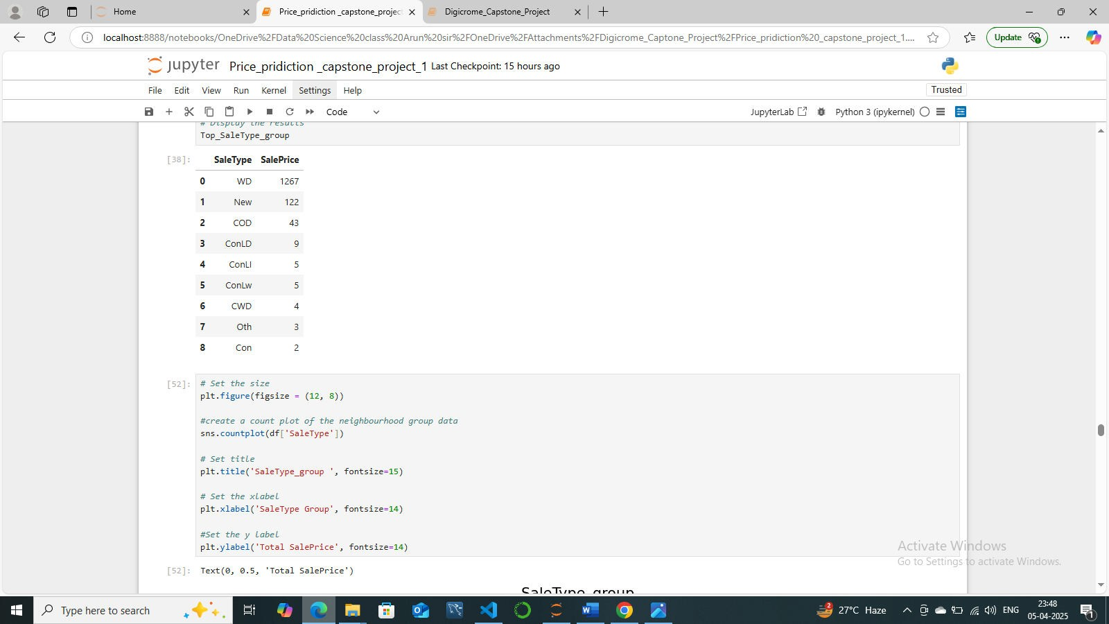

Slide 14
Scatterplot for numerical column

Slide 15
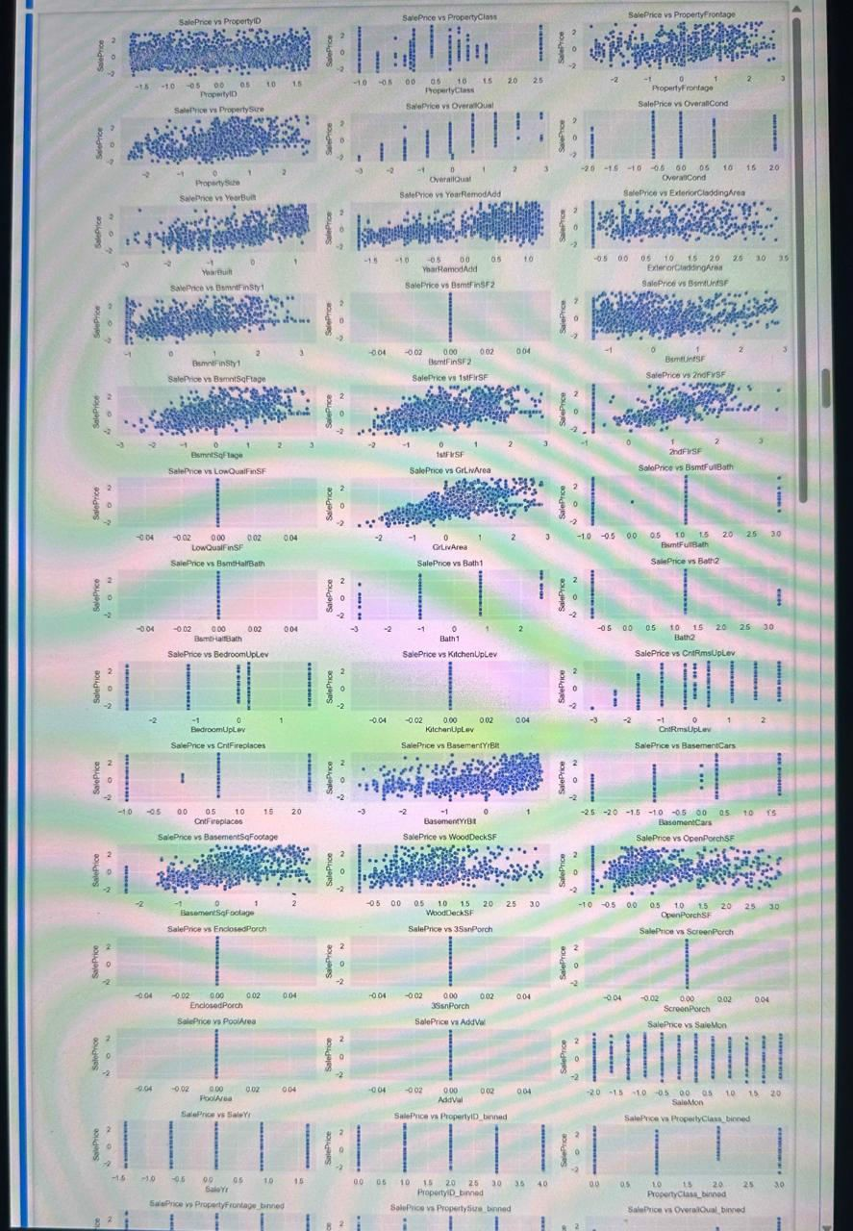

Slide 16
Box Plot for Categorical Plot

Slide 17
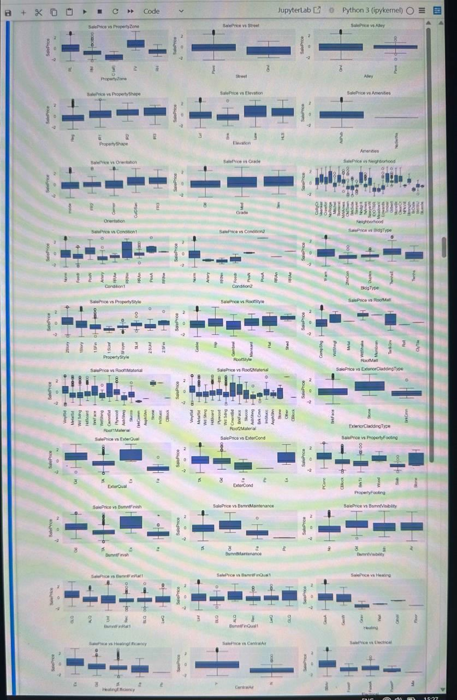

Slide 18
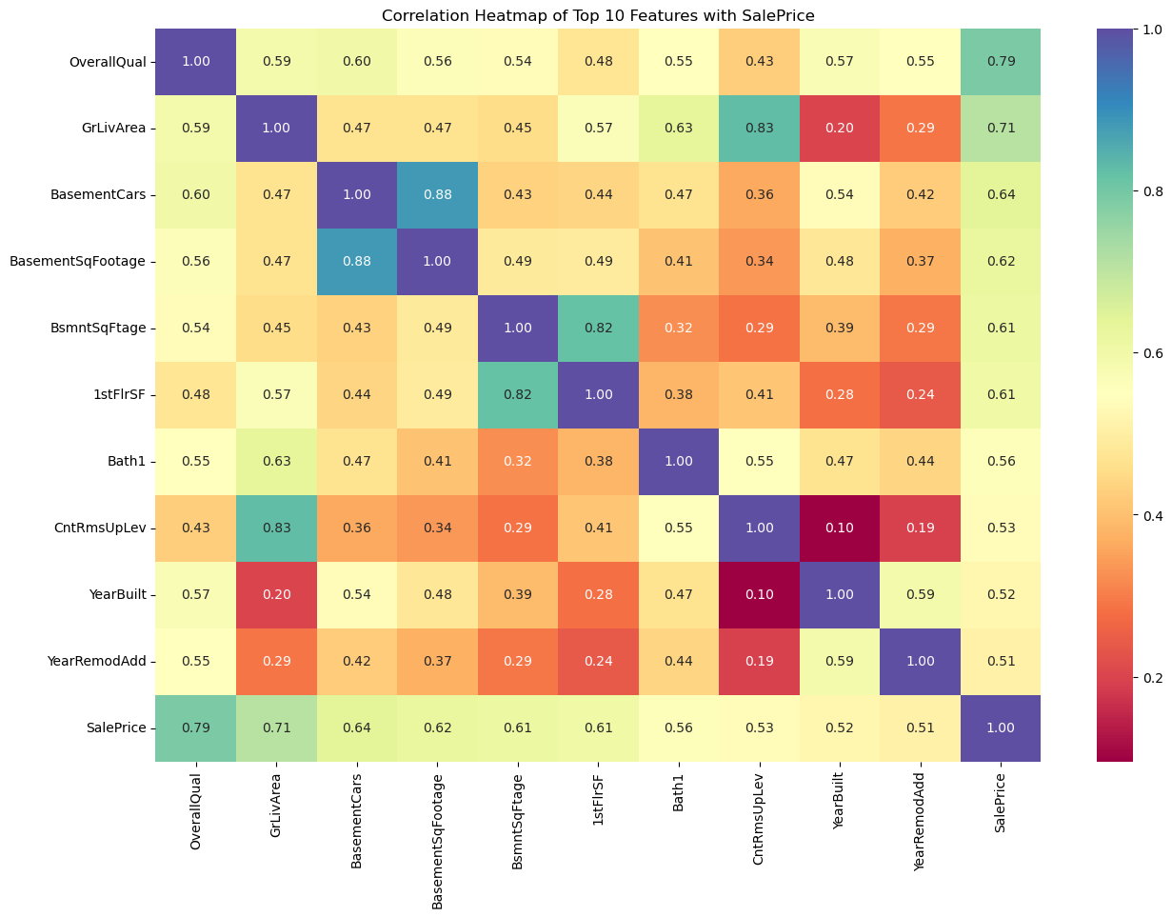
Heatmap
The heatmap allows for quick visual identification of strong positive or negative correlations between pairs of variables. High positive correlation values (close to 1) indicate that when one variable increases, the other tends to increase as well, while high negative correlation values (close to -1) indicate that when one variable increases, the other tends to decrease.

Slide 19
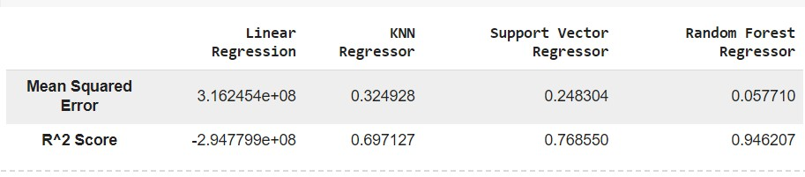
7. LEARNING OUTCOMES: -
The performance of the model and compare it with other machine learning algorithms.
A machine learning model that can predict property prices based on the selected variables.

Slide 20
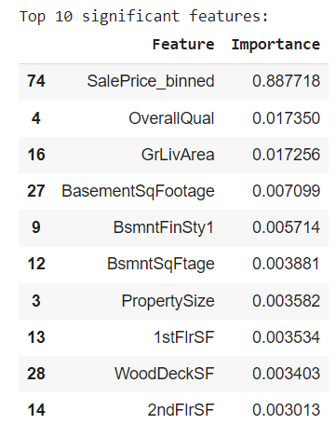
Based on the evaluation metrics provided for each regression model, here's a summary of the performance and the interpretation:
Linear Regression:
  Mean Squared Error (MSE): 0.5812
  R-squared (R^2) Score: -4.2637
  Interpretation: The linear regression model performs poorly, as indicated by the high MSE and a negative R^2 score. A negative R^2 score suggests that the model is worse than a horizontal line fitting the data, indicating that it fails to capture the variance in the target variable. This model is not suitable for predicting property prices in the specific location.
KNN Regressor:
  Mean Squared Error (MSE): 0.0741
  R-squared (R^2) Score: 0.3293
  Interpretation: The KNN regressor performs better than linear regression, as indicated by the lower MSE and a positive R^2 score. However, the R^2 score is relatively low, suggesting that the model explains only about 32.93% of the variance in the target variable. While an improvement over linear regression, this model may still not be sufficiently accurate for predicting property prices.

Slide 21
Support Vector Regressor (SVR):
  Mean Squared Error (MSE): 0.0562
  R-squared (R^2) Score: 0.4915
o
  Interpretation: The SVR model shows further improvement in performance, with a lower MSE and a higher R^2 score compared to the KNN regressor. The R^2 score of 0.4915 indicates that the model explains approximately 49.15% of the variance in the target variable. While an improvement over KNN, the model's performance may still not meet the desired threshold.
Random Forest Regressor:
  Mean Squared Error (MSE): 0.0147
  R-squared (R^2) Score: 0.8671
  Interpretation: The Random Forest regressor demonstrates the best performance among the models evaluated, with the lowest MSE and the highest R^2 score. The R^2 score of 0.8671 indicates that the model explains approximately 86.71% of the variance in the target variable, which is well within the expected range of 75%-85%. This model is considered highly accurate and suitable for predicting property prices in the specific location.
Overall, based on the evaluation metrics and the desired threshold for R^2 score, the Random Forest Regressor is the recommended model for predicting property prices in the specific location. It outperforms the other models and meets the expected R^2 score range of 75%-85%, indicating its effectiveness in capturing the variance in property prices.
8. CONCLUSION
Conclusion of the Project:
In this project, we aimed to develop a machine learning model to accurately predict property prices in a specific location. Through the systematic collection, preprocessing, and analysis of relevant data, we explored various regression algorithms, including Linear Regression, KNN Regressor, Support Vector Regressor, and Random Forest Regressor. Our primary goal was to identify the most effective model for predicting property prices, providing valuable insights and tools for real estate stakeholders.

Slide 22
Key Findings:
Model Performance:
  The Random Forest Regressor emerged as the best-performing model, with a Mean Squared Error (MSE) of 0.0147 and an R-squared (R^2) score of 0.8671. This model effectively explained approximately 86.71% of the variance in property prices, surpassing the expected threshold of 75%-85% and demonstrating high accuracy.
  Other models, including Linear Regression, KNN Regressor, and Support
Vector Regressor, showed inferior performance, with lower R^2 scores and higher MSE values, indicating their limited suitability for predicting property prices in the specified location.
o
Significant Features:
  The analysis revealed key features that significantly influence property prices. These features include property size, location-specific attributes, property age, number of rooms, and other relevant factors. Understanding these influential features helps stakeholders identify the primary drivers of property values in the area.
o
Insights for Stakeholders:
  The developed Random Forest Regressor model provides a reliable tool for real estate investors, property developers, and homebuyers to make informed decisions regarding property investments, developments, and purchases.
  The insights into significant features offer valuable information on market trends and factors driving property prices, enabling stakeholders to better assess property values and identify potential investment opportunities.
CITATIONS – BOOKS AND WEBSITES USED FOR RESEARCH.
Books:
  Introduction to Statistical Learning by Gareth James, Daniela Witten, Trevor Hastie, and Robert Tibshirani. This book provided foundational knowledge on various machine learning algorithms and their applications in predictive modeling.
  Hands-On Machine Learning with Scikit-Learn, Keras, and TensorFlow by Aurélien Géron. This book was instrumental in understanding the practical implementation of machine learning algorithms using Python libraries.

Slide 23
Pattern Recognition and Machine Learning by Christopher Bishop. This book offered insights into advanced machine learning techniques and their theoretical underpinnings.
Websites:
Scikit-Learn Documentation: https://scikit-learn.org/stable/documentation.html
  Essential for understanding the implementation details and parameters of machine learning algorithms used in the project.
Towards Data Science: https://towardsdatascience.com/
  Articles and tutorials on machine learning, data preprocessing, and feature engineering were valuable for practical implementation tips and best practices.
Analytics Vidhya: https://www.analyticsvidhya.com/
  Provided articles on data science and machine learning techniques, including the use of Random Forest Regressor and other algorithms for predictive modeling.
Real Estate Websites: (e.g., Zillow, Realtor, etc.)
  Used to gather insights on property features and market trends relevant to the specific location studied in the project.
Journals and Research Papers:
Research papers on real estate price prediction and the application of machine learning in real estate markets were reviewed to understand the current state of the field and methodological approaches.
|| THANK YOU ||

